Slide 1
COMP 2230
Week 5 - Monday

Slide 2
Last time
Sequences
Summation notation
Product notation
Mathematical induction

Slide 3
Questions?

Slide 4
Assignment 2

Slide 5
Logical warmup
Roger Rabbit needs to hop down ten stairs.
He can hop down either one or two steps at a time.
How many different ways can he get down the stairs?

Slide 6
Exam 1 Post Mortem

Slide 7
Induction Examples

Slide 8
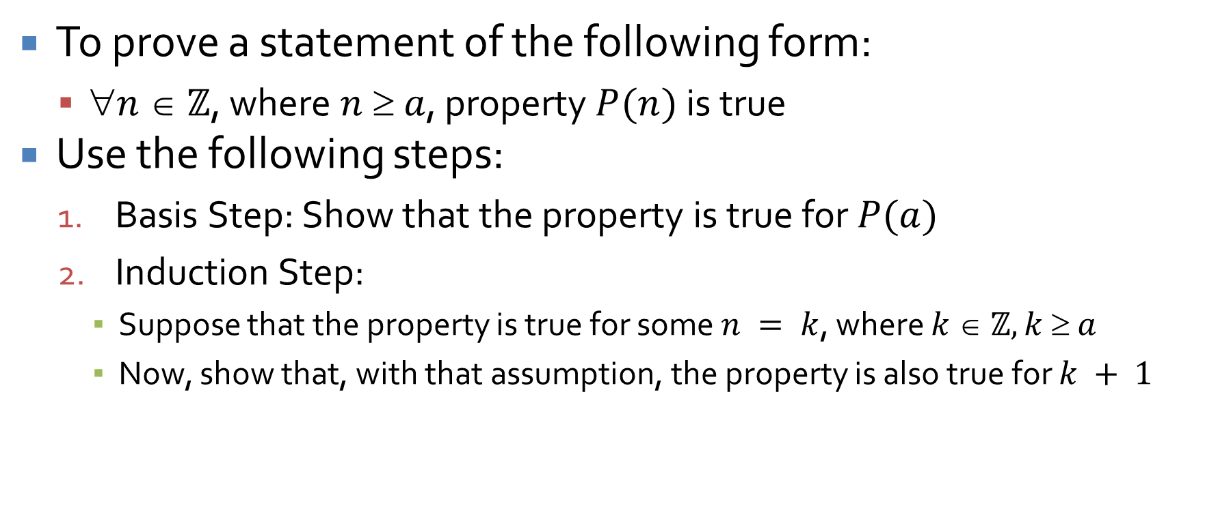
Proof by mathematical induction
To prove a statement of the following form:
  $n  ℤ$, where $n  a$, property $P(n)$ is true
Use the following steps:
  Basis Step: Show that the property is true for $P(a)$
  Induction Step:
    Suppose that the property is true for some $n = k$, where $k  ℤ, k  a$
    Now, show that, with that assumption, the property is also true for $k + 1$

Slide 9
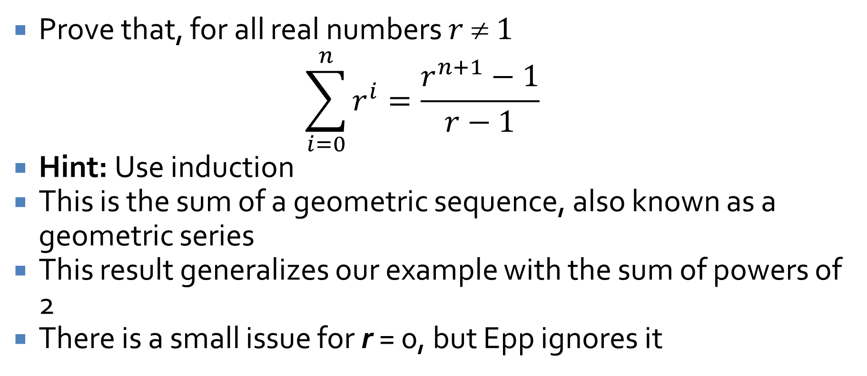
Geometric series
Prove that, for all real numbers $r  1$
$$\sum_{i=0}^{n}{r^{i}=\frac{r^{n+1}−1}{r−1}}$$
Hint: Use induction
This is the sum of a geometric sequence, also known as a geometric series
This result generalizes our example with the sum of powers of 2
There is a small issue for r = 0, but Epp ignores it

Slide 10
Ticket Out the Door

Slide 11
Upcoming

Slide 12
Next time…
Finish induction examples
Strong induction
Recursively defined sequences
Solving recurrence relations by iteration

Slide 13
Reminders
Keep working on Assignment 2
Read 5.4, 5.6, and 5.7

